Slide 1
Status Consumption under extreme inequalities
Department of Economics
a.srivastava@pgr.reading.ac.uk

Slide 2
Conspicuous or Status Consumption
It is the tendency of consumers to indicate status by using goods of a higher quality or in higher quantity than what might be considered necessary
What is necessity?
Literature considers both - the so-called Townsend view (subjective preferences are needs) and social-welfare view (i.e. the polar opposite view)
Visible consumption – is the most generally accepted view on status consumption

Slide 3
Testing for status consumption in developing countries with extreme inequalities
Different perspectives
Status consumption must exist
Regardless of poverty levels, status competitions are universal
There is a reference level for all consumer choice (poorer countries have a lower reference level)
Status consumption cannot exist
Most consumers struggle to meet basic needs. So status is inseparable from fulfilling basic needs
The income differences are wide, starkly visible for there to be any use of status consumption

Slide 4
Why do we want status goods?
A few perspectives:
Veblen : Signaling is inherent in all consumption
Hirsch: Post-war commercialisation and advertising has removed the difference between necessities and quality (physical and social scarcity)
Baudrillard : The “active manipulation of signs”– the mechanism to insert oneself within the consumer society (and working to differentiate oneself from others) is itself a form of labour
Frank: The consumer improves self-image and felicity through status competitions (subject to their reference point) – This allows us an empirical assessment

Slide 5
Question: Inequality and Non-Necessary Consumption
Does more inequality lead to a segregation of demand so that the consumers don’t compete within the same status competitions and have discordant status consumption (segregated by wealth/class)?
Does more inequality intensify status competitions and increase status consumption?
How can we test above empirically?

Slide 6
Does consumption influence status?
To have a model for status – consider first if viewed as a social position based on wealth/occupation, status determines consumption or consumption itself drives status?
This is an empirical assessment and requires us to define what status and status goods mean in a given socio-cultural context
We take a general view – considering status as both wealth and consumption
The non-durable consumption relevant for status is in excess of needs
This allows us to compare status consumption across disparate economies

Slide 7
Status and Consumption
Two key assumptions support our definitions and model:
A1. Rational Benefit from status consumption - There is a rational benefit to be had from status consumption (otherwise consumers would stay away from it in the long-run). This ensures that all consumers –benefit from high non-durable consumption relative to their needs
A2. Longevity of Durable goods - Status-related consumption that is considered “wealth” can be inherited. This separates the long-term consumption from short-term consumption in the context of differences in consumer wealth levels

Slide 8
Defining Excess Non-Durable Consumption
How do we define needs?
We accept the Doyal-Gough view and consider needs as only a guarantee of health and autonomy. Thus status is not a basic need.
Defining Excess : Arguing that different households cannot have different basic needs except for age-composition and household size, we argue that
Anything above the cost of needs is of some potential status value to the consumer
Any durable goods purchased are also of some status value
All else are basic needs
Empirical consideration of needs: We argue that food would carry some status value in societies where food security problems are widespread

Slide 9
Defining Durable Consumption
Durable goods that can be transferred over a generation are relevant for status consumption – effectively serving as proxy of wealth. All else is non-durable consumption.
The LSMS survey which we rely upon provides assets owned by consumers for all the countries surveyed.

Slide 10
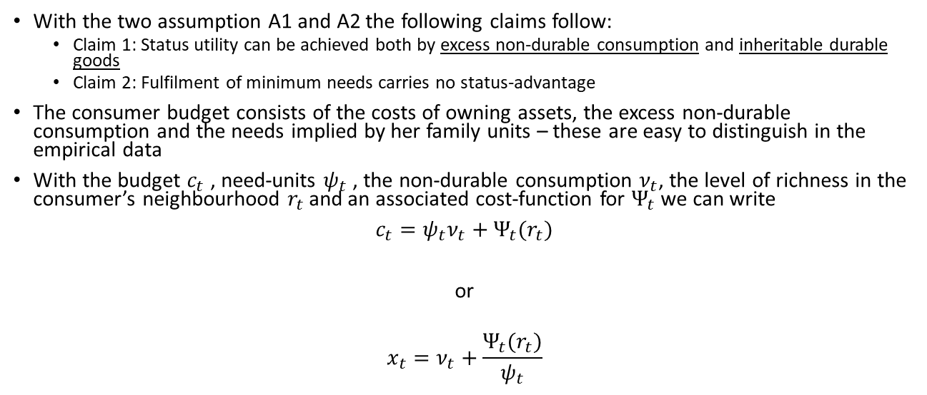
Modelling Status Consumption
With the two assumption A1 and A2 the following claims follow:
Claim 1: Status utility can be achieved both by excess non-durable consumption and inheritable durable goods
Claim 2: Fulfilment of minimum needs carries no status-advantage
The consumer budget consists of the costs of owning assets, the excess non-durable consumption and the needs implied by her family units – these are easy to distinguish in the empirical data
With the budget $c_{t}$ , need-units $ψ_{t}$ , the non-durable consumption $ν_{t}$, the level of richness in the consumer’s neighbourhood $r_{t}$ and an associated cost-function for $Ψ_{t}$ we can write
$c_{t}=ψ_{t}ν_{t}+Ψ_{t}(r_{t})$
or
$$x_{t}=ν_{t}+\frac{Ψ_{t}(r_{t})}{ψ_{t}}$$

Slide 11
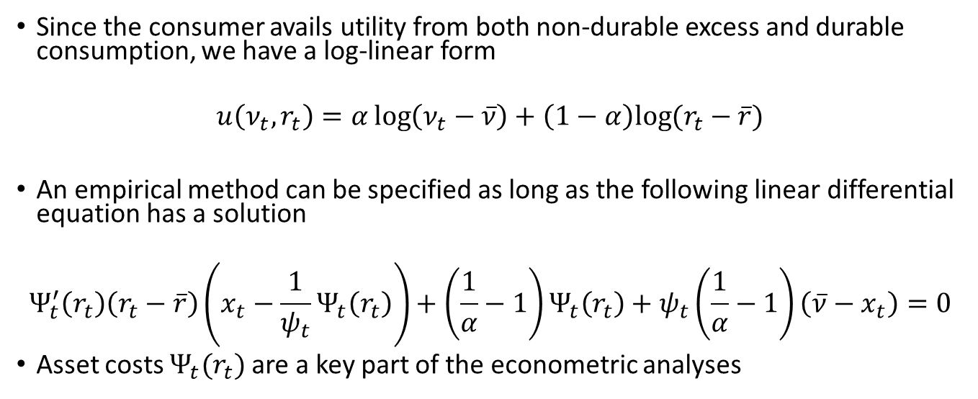
A model for Status Demand (contd.)
Since the consumer avails utility from both non-durable excess and durable consumption, we have a log-linear form
$$u\left(ν_{t},r_{t}\right)=α\log\left(ν_{t}−\overline{ν}\right)+\left(1−α\right)log⁡(r_{t}−\overline{r})$$
An empirical method can be specified as long as the following linear differential equation has a solution
$$Ψ_{t}^{′}\left(r_{t}\right)\left(r_{t}−\overline{r}\right)\left(x_{t}−\frac{1}{ψ_{t}}Ψ_{t}\left(r_{t}\right)\right)+\left(\frac{1}{α}−1\right)Ψ_{t}\left(r_{t}\right)+ψ_{t}\left(\frac{1}{α}−1\right)\left(\overline{ν}−x_{t}\right)=0$$
Asset costs $Ψ_{t}(r_{t})$ are a key part of the econometric analyses

Slide 12
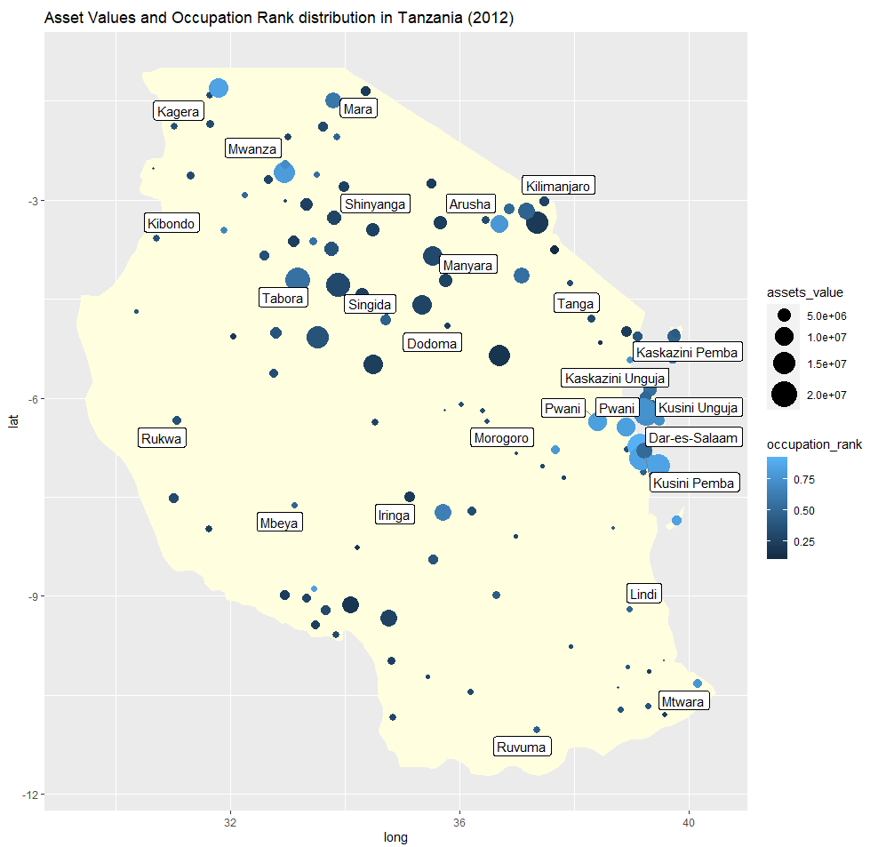
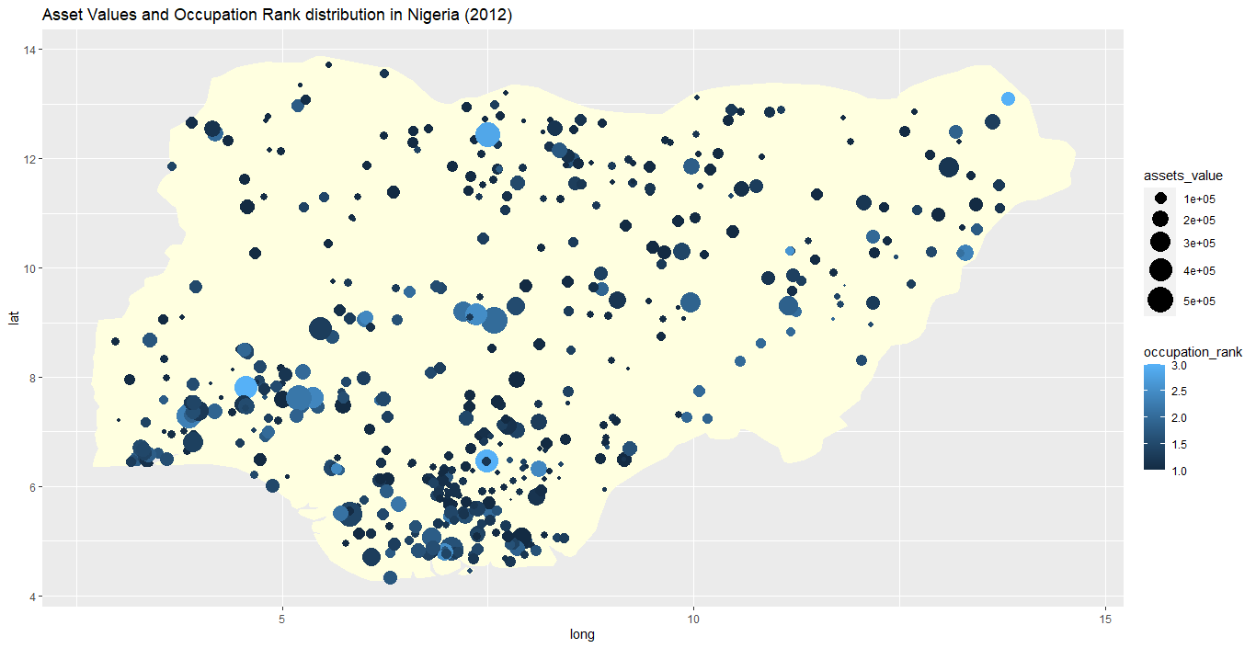
Comparing Tanzania and Nigeria – occupational and asset differences across region
Using income data, we standardise occupations into occupation ranks for comparison across economies
Occupational and Asset differences are shown in the following chart. A more even distribution of assets and occupation-levels seems evident in Nigeria.

Slide 13
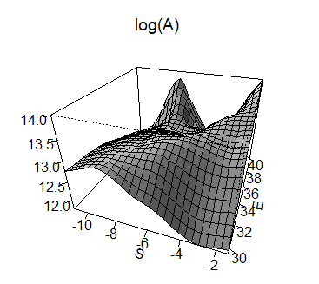
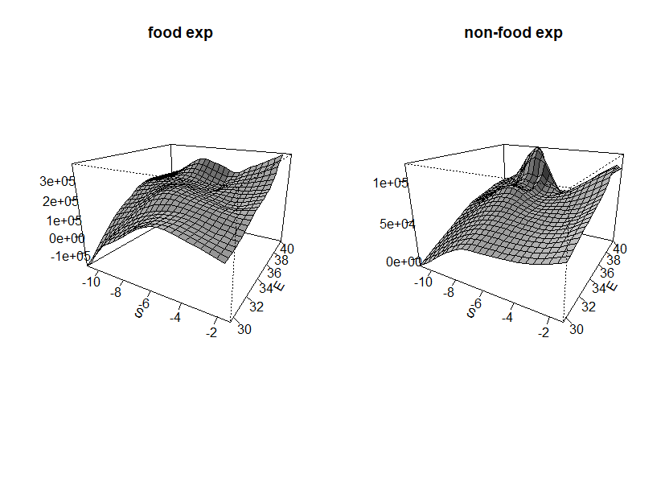
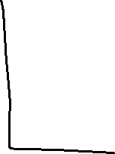
Tanzania – A non-parametric view
Vast differences in asset ownership across the country
Non-food expenditures are much higher in the east

Slide 14
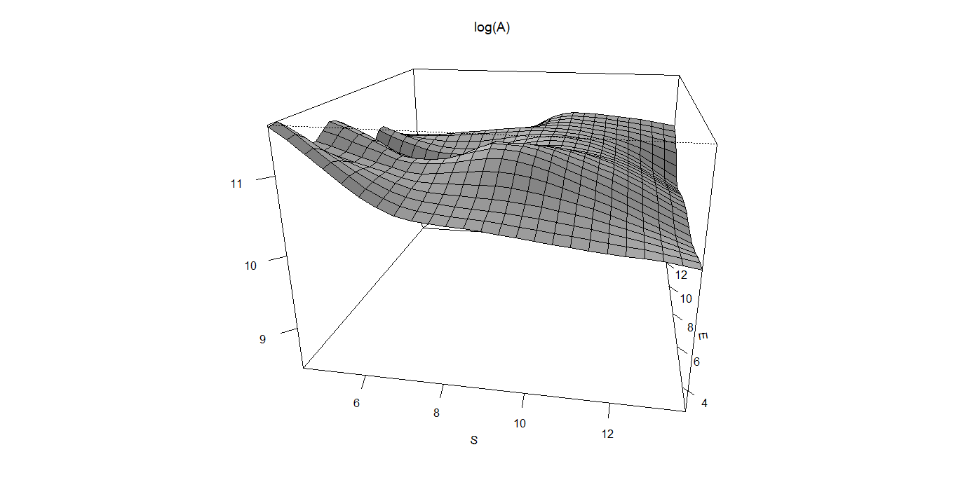
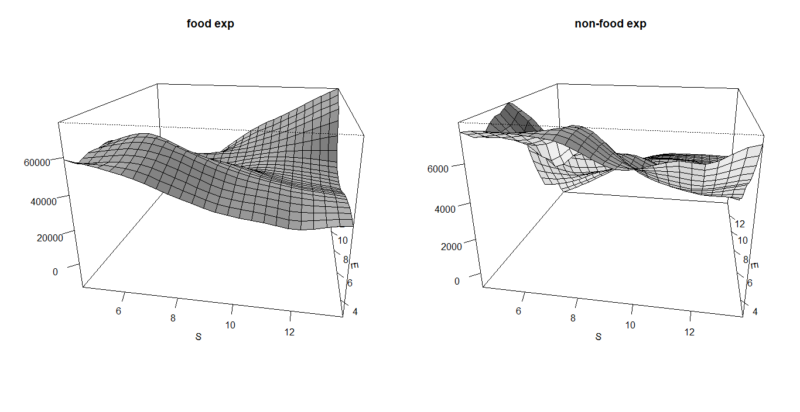

Nigeria – A non parametric view
The asset differences are relatively flat
The north-east of the country has higher food expenditure but the coastal south-west has higher non-food expenditure

Slide 15
Interpreting non-parametric and descriptive data
Tanzania
There are vast differences in asset ownership
Occupational differences across regions are high
The south and east of Tanzania are too far apart in assets and have incomparable amenities. This is less so in the central parts
The subjective well being data also does not align with the asset distribution.
Nigeria
The asset differences are fewer
Occupational and educational differences are more uniform across regions

Slide 16
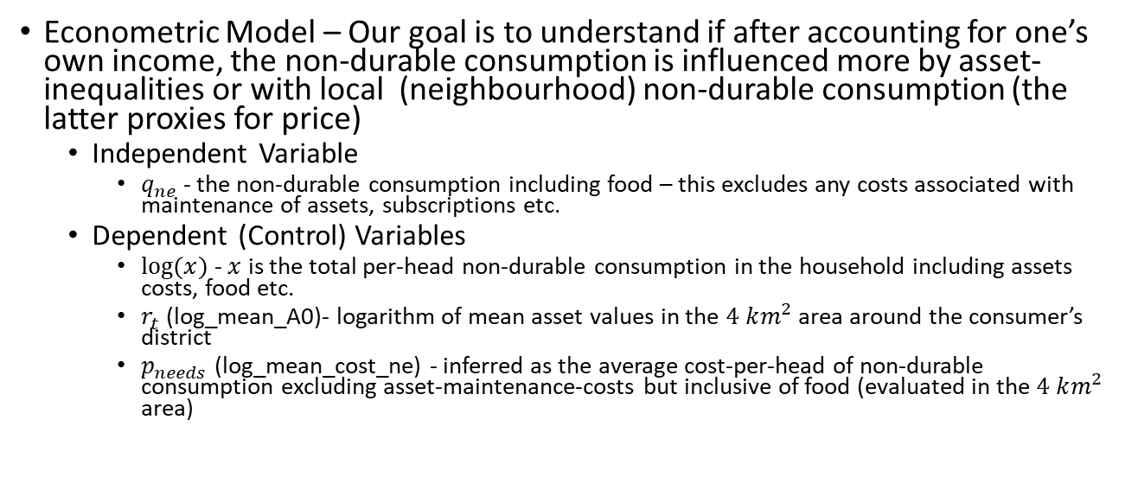
Parametric Analysis
Econometric Model – Our goal is to understand if after accounting for one’s own income, the non-durable consumption is influenced more by asset-inequalities or with local (neighbourhood) non-durable consumption (the latter proxies for price)
Independent Variable
$q_{ne}$ - the non-durable consumption including food – this excludes any costs associated with maintenance of assets, subscriptions etc.
Dependent (Control) Variables
$log⁡(x)$ - $x$ is the total per-head non-durable consumption in the household including assets costs, food etc.
$r_{t}$ (log_mean_A0)- logarithm of mean asset values in the $4 km^{2}$ area around the consumer’s district
$p_{needs}$ (log_mean_cost_ne) - inferred as the average cost-per-head of non-durable consumption excluding asset-maintenance-costs but inclusive of food (evaluated in the $4 km^{2}$ area)
Notes:
The idea is that the consumer spending on non-durable consumption inclusive of food is influence by her total expenditure (depending on her own income) and the overall factors.

Slide 17
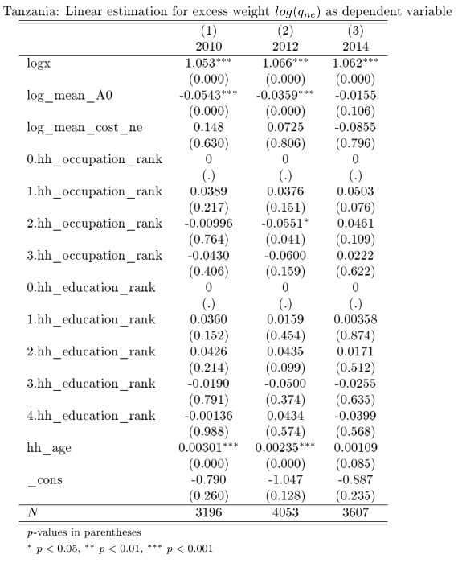
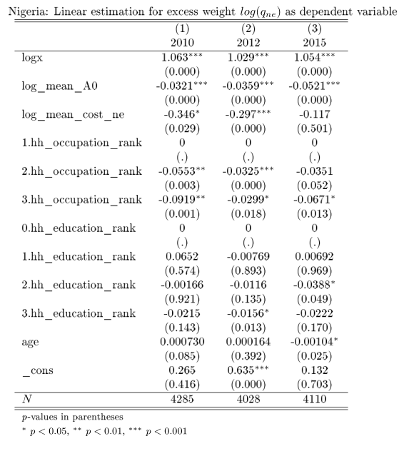

Cross-Sectional View – role of asset costs
$logx$ - the total per-head non-durable consumption including assets costs, food
$r_{t}$ (log_mean_A0)- logarithm of mean asset values in the $4 km^{2}$ area
$p_{needs}$ (log_mean_cost_ne) - average cost-per-head of non-durable consumption excluding asset-maintenance-costs
Notes:
1. Prices for nde move together with assets in Nigeria. When you’re in a rich area you’re consuming less non-durable consumption relative to average.
2. Mobility may be higher in Nigeria - Higher occupations have difference consumption in Nigeria

Slide 18
Implications for status consumption
Asset costs rise more significantly in Nigeria leading to lower non-durable consumption when non-durable consumption prices rise . Thus, when you’re in a rich area, average non-durable expenditure (nde) is generally higher relative to which the nde is lower
On the other hand, the nde is more varied in Tanzania and assets seem to matter less for non-durable status consumption as asset costs don’t change much (this could also mean that food is more important and expensive in Tanzania – therefore less role of asset costs)
Status competitions seem more intense in Nigeria – also because higher occupations have different consumption

Slide 19
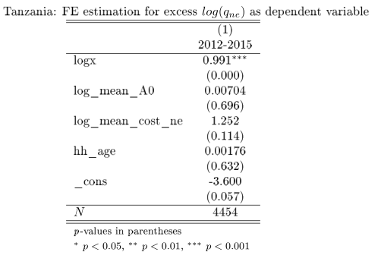
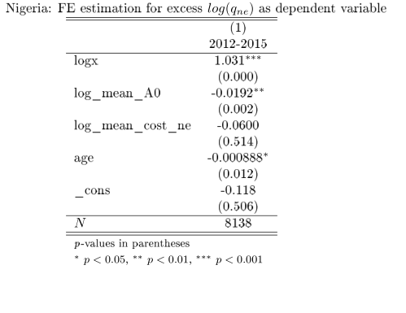


Panel View
Notes:
Substitution. In other words, as consumers become asset-richer in the area, their nde goes down. But in Tanzania, the substitution is between mean-cost-ne and nde.

Slide 20
Summary of observations from the Panel and Cross-Section Analysis
The economic significance of local (neighborhood) expenditure is generally high
There is a substitution between asset-richness and non-durable consumption in Nigeria. This is less so in Tanzania.
For the same household, changes in asset-richness seems to drive consumption of non-durable goods in Nigeria. Asset-costs don’t increase significantly for consumer in richer areas in Tanzania.
The role of education as well as occupation for non-durable consumption seems stronger in Nigeria

Slide 21
Conclusions
A necessary implication of the model is that consumers with both lower durable consumption and lower relative excess cannot compete with the consumer for whom both are higher
This effect is stronger in Tanzania than in Nigeria
With the most commonly accepted notion of status consumption, Tanzania seems to have less status consumption
In both economies, the effect of urban-rural differences dominates the notion of visible consumption

Slide 22
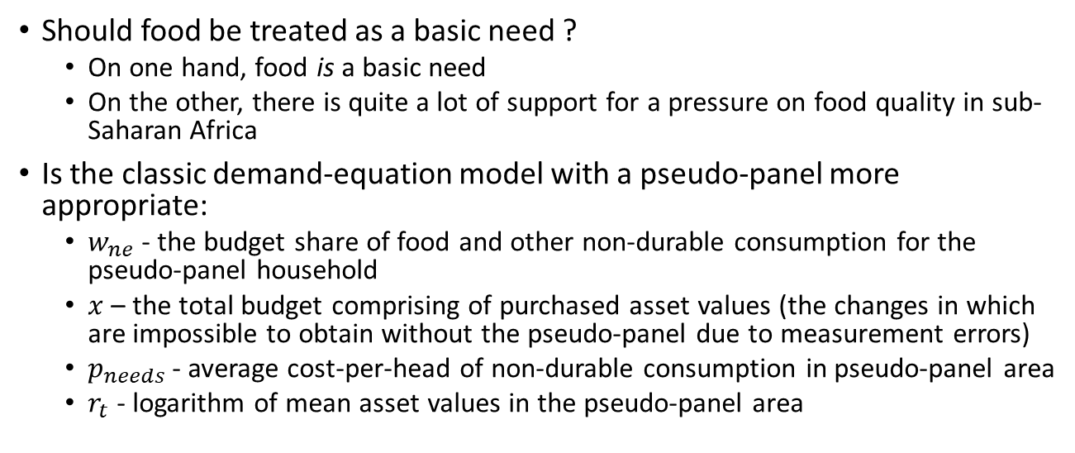
Discussion
Should food be treated as a basic need ?
On one hand, food is a basic need
On the other, there is quite a lot of support for a pressure on food quality in sub-Saharan Africa
Is the classic demand-equation model with a pseudo-panel more appropriate:
$w_{ne}$ - the budget share of food and other non-durable consumption for the pseudo-panel household
$x$ – the total budget comprising of purchased asset values (the changes in which are impossible to obtain without the pseudo-panel due to measurement errors)
$p_{needs}$ - average cost-per-head of non-durable consumption in pseudo-panel area
$r_{t}$ - logarithm of mean asset values in the pseudo-panel area

Slide 23
References
A Deaton, Understanding Consumption, Clarendon Press 1993
L Doyal and I Gough, A Theory of Human Need, Palgrave London 1991
Robert H Frank, “The Demand for Unobservable and Other Nonpositional Goods”, The American Economic Review, vol. 75(1), pp. 101-116

